Slide 1
COSC 4P02:
Brock University Chatbot
Marmik Bhatt, Lucas Kumara, Liam Mckissock, Tom Wallace, Hyejin Kim, Aedal Panicker, Jakob Shortell

Slide 2
Team Member Roles
Marmik Bhatt (Team Leader)
Tasked with facilitating team meetings
Created project reports and stayed in contact with both the TA and Professor regarding questions/deadlines
Helped develop the first iteration of the front end, as well as created the introductory modal and chatbot status indicator
Tom Wallace
Created some scrapers, and helped ensure proper function of other scrapers
General assistance with aspects of both frontend and backend
Lucas Kumara
Handled initial structuring of the project (setting up React, Flask and ensuring communication between them)
Implemented a modular scraper system as well as a SQLite database for data to be stored and retrieved
Modified first iteration of the front end to what is now the finalized version
Created the automated testing harness and wrote several tests
Aedel Panicker
Worked on scrapers and setting up the SQL database
Helped write some tests

Slide 3
Team Member Roles (cont. )
Liam Mckissock
Worked on the natural language processing, with NLTK and TensorFlow
Created the Intents files for training the model
Created some of the scrapers; Contacts, Weather, Brock News, Niagara News, Niagara Events, etc.
Worked on various aspects for both the front-end as well as the back-end
Jakob Shortell
Did initial research on natural language processing
Worked on and created scrapers; Courses, Schedule
Worked on web hosting and creating project docker containers
Hyejin Kim
Created some of the scrapers, such as transportation and restaurant
Helped with modularization of the code, such as cleaning codes and comments

Slide 4
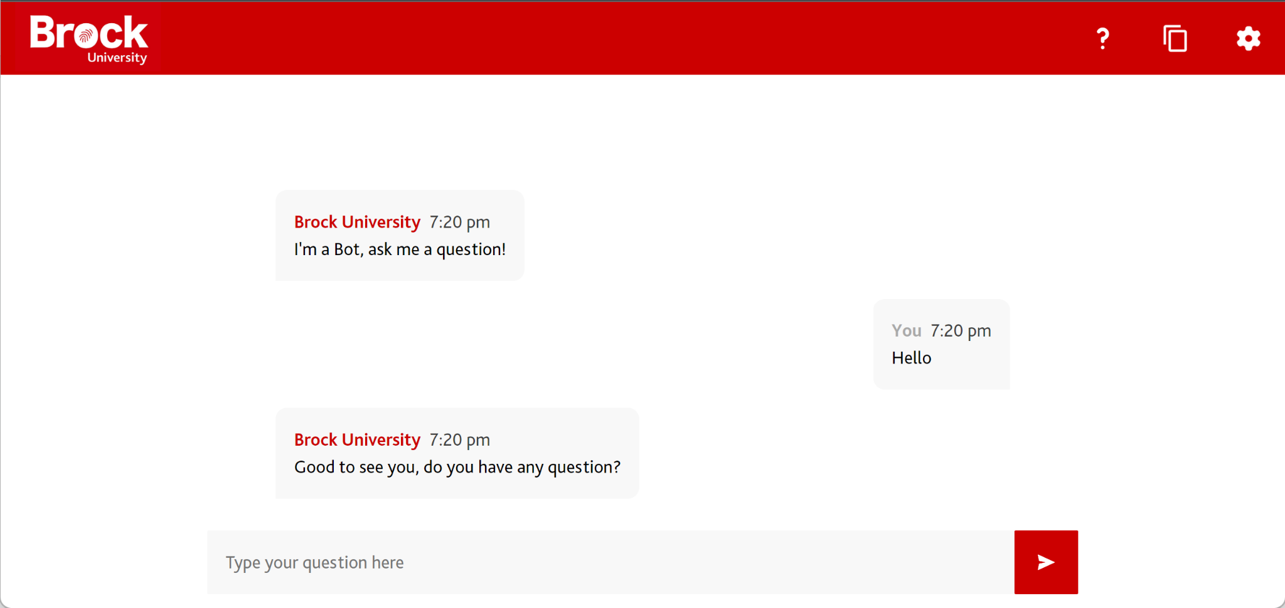
Front End
React
React allowed us to break down our front end into components such as the header, message container, modal, etc. allowing us to keep the project organized
The front end provides the user with a number of options in the header such as a button to get help, copy the chat log and a settings menu where the user can tweak options such as the language
React is responsible for the UI, and also sends user input to the backend via POST requests and shows the user the chatbots response

Slide 5
Obtaining Information
The chatbot makes use of web scrapers in order to obtain information from the Brock University website. Numerous different scrapers were created to obtain different pieces of information from different parts of the website.
Database Scrapers
Courses + Details
Programs
Faculty Contact Information
Exam Dates + Details
Departments
Clubs
Building Information
Restaurants
Transportation
Important Dates
Live Scrapers
Brock News
Brock Events
Niagara News
St. Catharines Weather

Slide 6
Natural Language Processing
The Natural language processing was done using the NLTK, Numpy and TensorFlow python libraries
NLTK (Natural Language Toolkit)
NLTK was used for tokenizing the questions into separate words and each word was stemmed after. Example: “Going” is stemmed to “Go”
Numpy
The words are bagged into an indexed array that is ordered using Numpy
TensorFlow
TensorFlow was used to create an AI model by training using the intents files

Slide 7
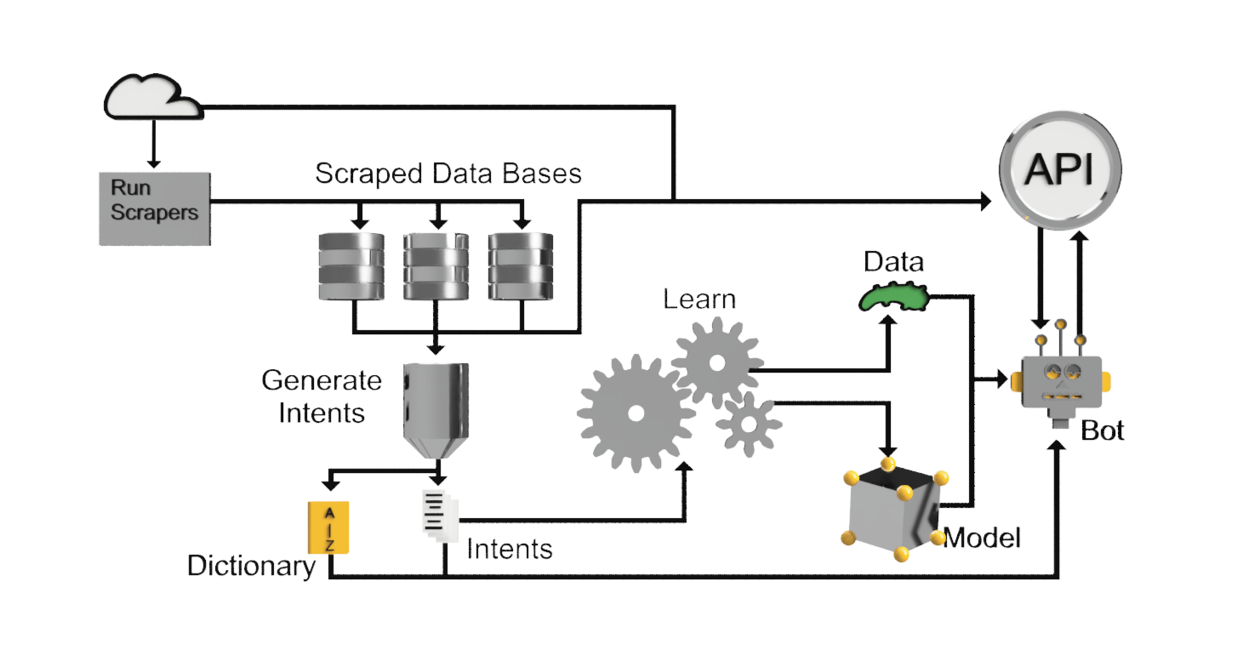
Back-end Diagram

Slide 8
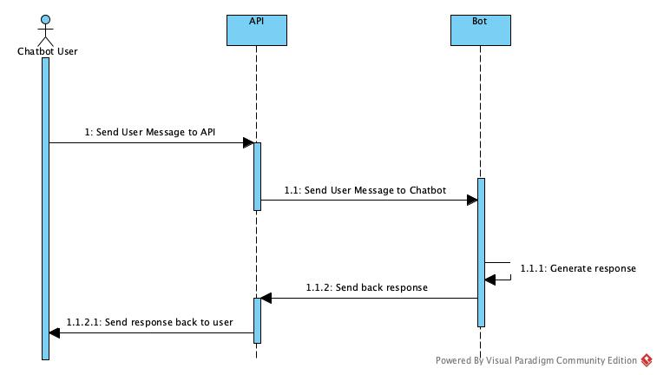
Sequence Diagrams

Slide 9
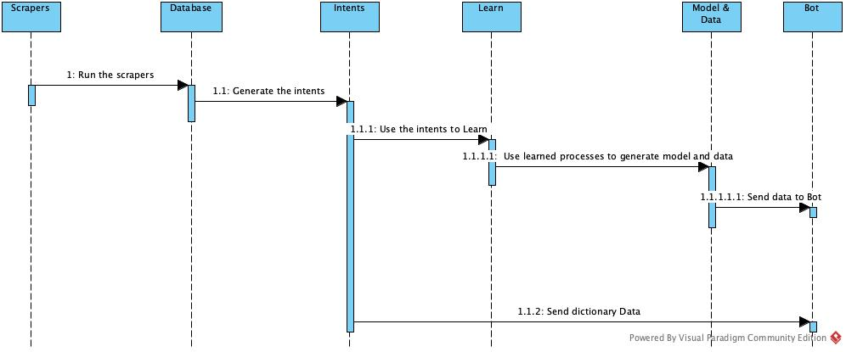
Sequence Diagram (cont.)

Slide 10
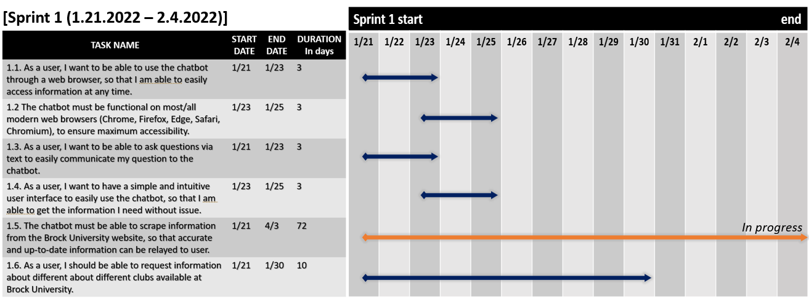
Sprint 1
Sprint 1 consisted of creating a basic front end, getting a backend scraper working for proof of concept, and getting the front and back end to communicate with each other
For the front end a basic message input/output board was created for chatbot interaction
In the backend the clubs scraper was created so the chatbot had some information to display
The react and flask components of the chatbot were connected

Slide 11
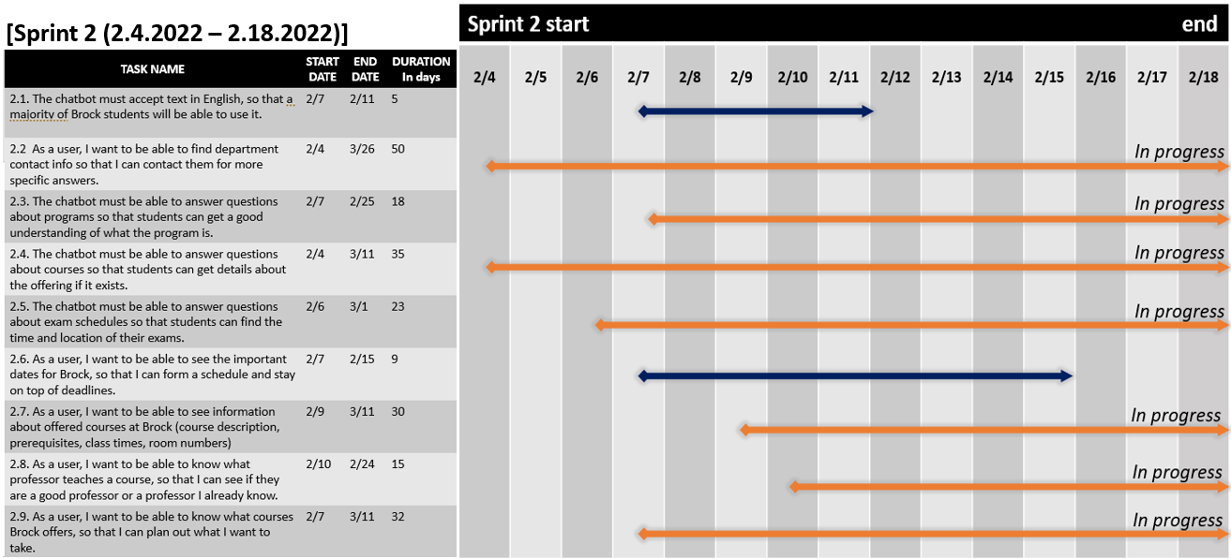
Sprint 2
Sprint 2 consisted of minor updates to the front end as well as getting the majority of the scrapers finished
The front end was cleaned up and some functionalities were added
Almost all of the scrapers for the chatbot were finished; however, due to the inconsistent nature of the Brock University webpages, some of the scrapers planned for the sprint were not finished in time and were moved to the next sprint

Slide 12
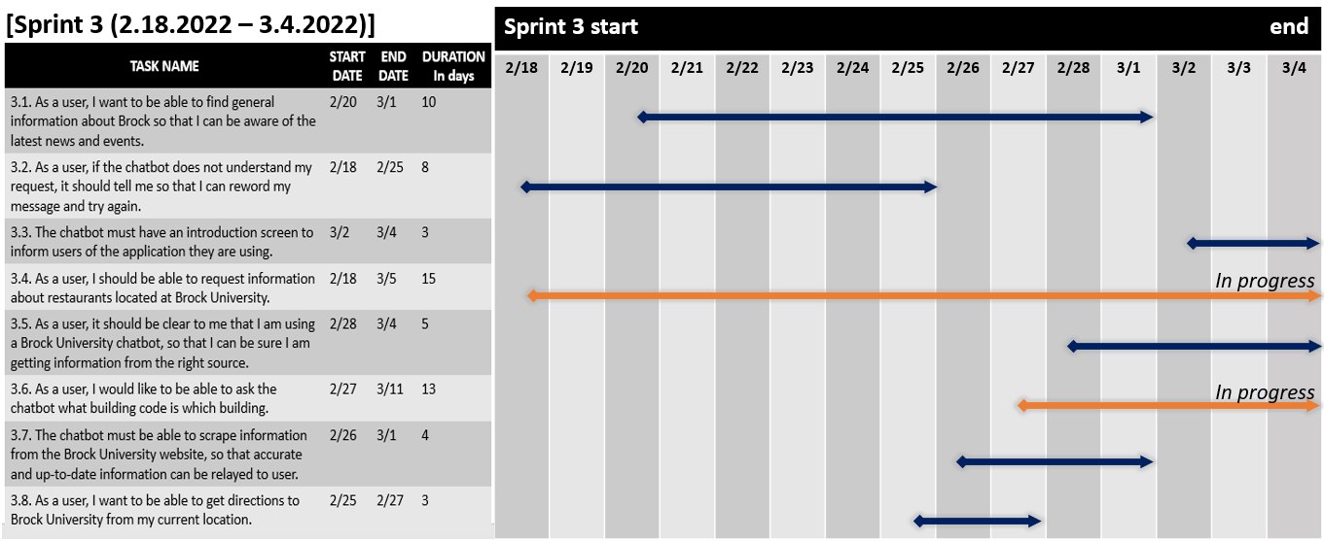
Sprint 3
Sprint 3 also consisted of minor updates to the UI, the addition of some unfinished scrapers, and A.I. for the chatbot to read messages
The front end was given a modal to give users information and a settings icon was created with no real functionality at this stage
Scrapers unable to be finished as well some other final scrapers to be added were finished during this sprint
The chatbot was given A.I. through the python NLTK and Tensorflow libraries

Slide 13
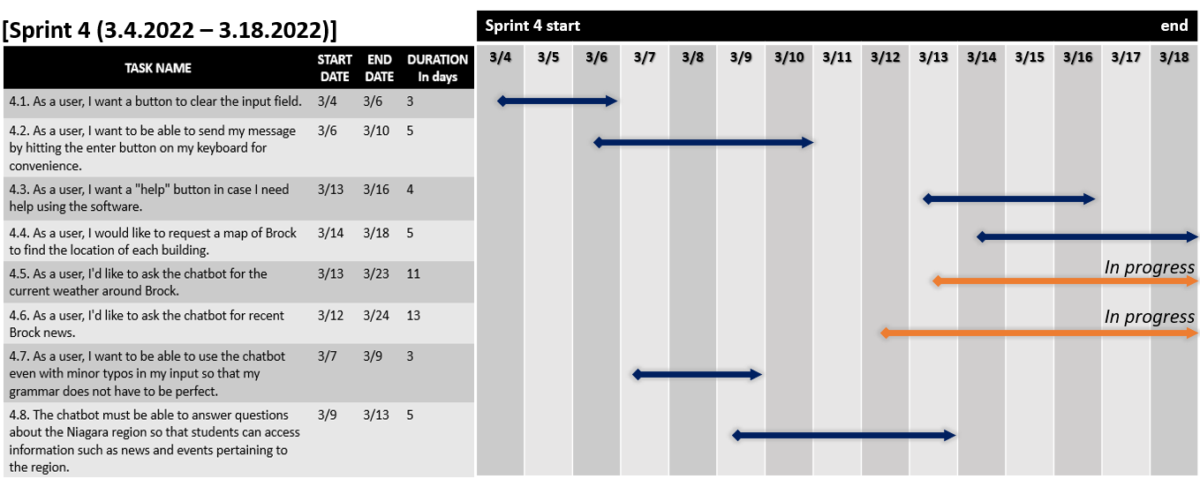
Sprint 4
Sprint 4 consisted mostly of updates to the UI, some on-request scrapers were added, and the A.I. was updated
A help icon, a clear button and ability to show maps was added to the UI
Real time scrapers such as information on weather and on Brock news were added
The A.I. was given a larger pool of information to learn from and has the added functionality to autocorrect misspelled words

Slide 14
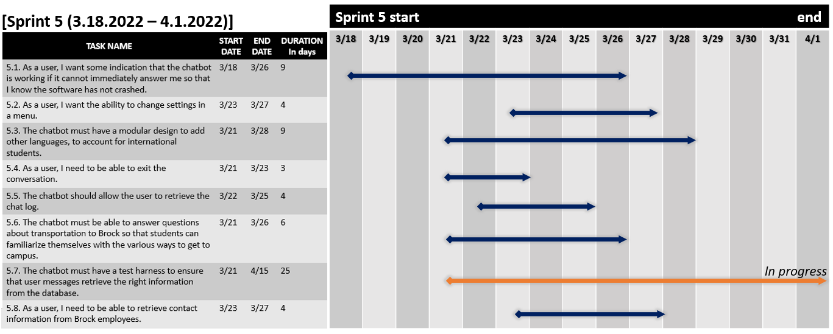
Sprint 5
In sprint 5 more UI was added, some scrapers that we realized would be valuable but were not initially planned were added, and the beginning of a test class was created
The settings options were completed and a loading message icon was added to the front end
Extra scrapers were added to the back end
A test class with mostly empty test was added with tests to be created in the next sprint

Slide 15
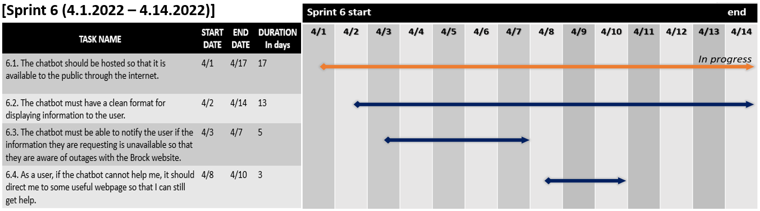
Sprint 6
Within Sprint 6, we focused on more quality of life issues within the application.
The web application was hosted on a platform through digital ocean
We focused on cleaning up the format of the messages
Also prompted the chat bot to respond accordingly if the information the user was requesting was unavailable or the chatbot was out of service.

Slide 16
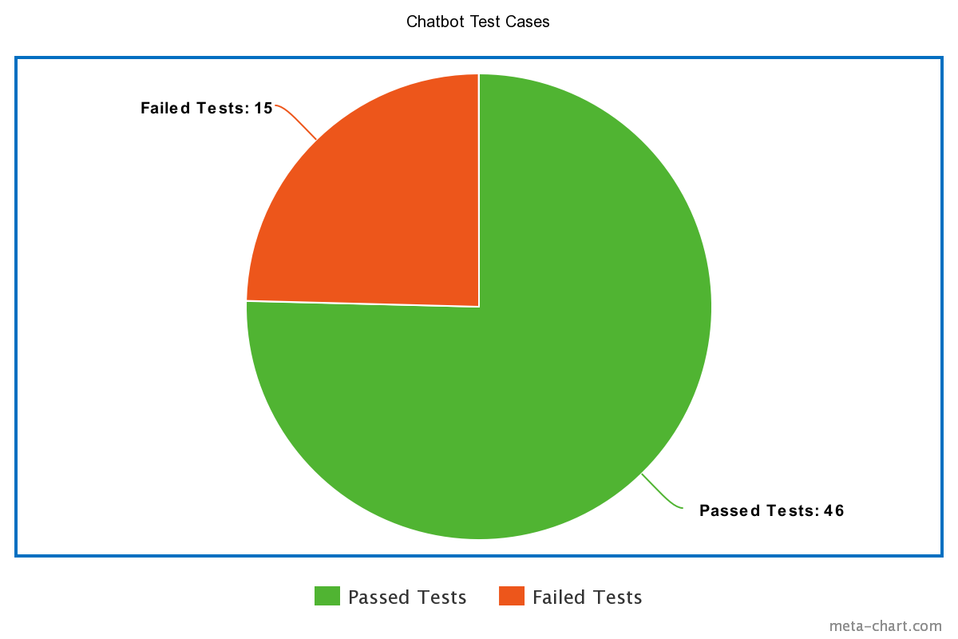
Testing
Automated testing was implemented in order to ensure that user input would retrieve the right information
Tests were created for various requests of different data, asking for data in different ways, and ensuring the bot worked with improper grammar and spelling
12 of the 15 failed tests were tests involving incorrect grammar

Slide 17
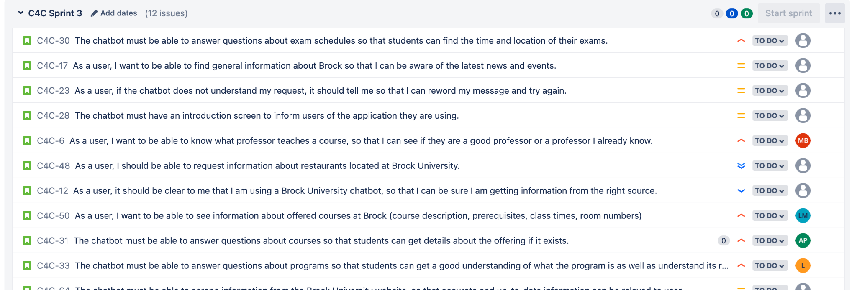
Design Methodology
The methodology followed throughout this process was the scrum methodology
This revolved around us setting up a product backlog based on the provided requirements document
Before the development process began, we set up the initial sprint backlogs based on mission critical components
Throughout the process we met up for daily scrum meetings on Tuesdays and Fridays at 6:30 pm EST broken down into 2 week sprints.
The purpose of the recorded meetings was to discuss progress, shift around sprint backlog items and voice any concerns the development team may have had.

Slide 18
Web hosting
We utilized docker, specifically docker compose which is designed for use with projects that have multiple parts
A container for the front end which runs an Nginx server for displaying the React interface
A container for the backend that uses Gunicorn to act as a server for the flask
Using docker also allowed us to build the project locally to verify it was working properly before deployment
This also made it so that we could easily deploy the project on any hosting service we wanted to use with minimal changes or configuration needed

Slide 19
Issues Faced
There were various technical issues that were faced during the development process
The handling of web scraping
How do we handle scraping aspects of the sites that are so different from one another?
Issue of web hosting
Finding and setting up a suitable Host for our Chatbot application, based on our current memory requirements.

Slide 20
Reflection
What would we have done different?
Put an earlier emphasis on hosting…
As discussed earlier this became a bit of a problem, because of various issues
Focus on the aspect of more memory efficient code

